Slide 1
BUS7C1 CORPORATE STRATEGY AND INTERNATIONAL MANAGEMENT
Lecture 8
Lecturer: Elan Kandaswamy

Slide 2

By the end of today you will be able to…
Assess who should be involved in strategising
Recognise key tasks performed by strategists
Understand and apply the key stages of a strategic plan

Slide 3
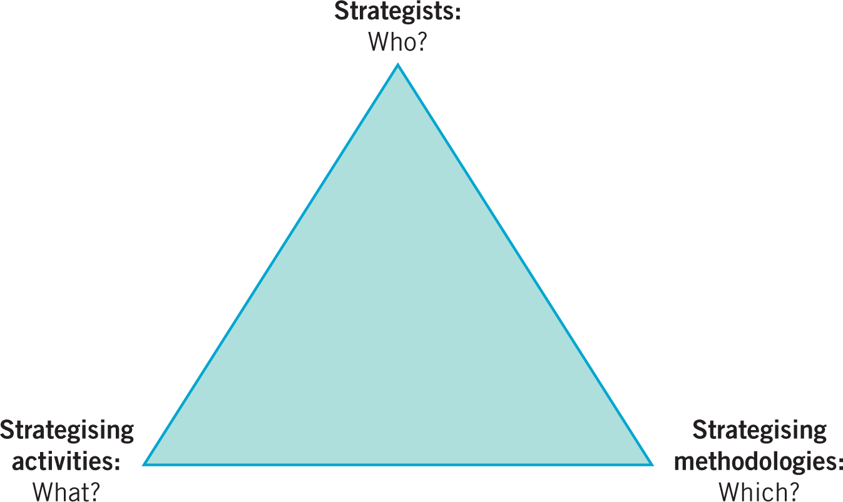
The pyramid of strategy practice

Slide 4
The strategists – top managers and directors
Chief executive officer – often seen as
the strategic leader but need to avoid
excessive personalisation of the
strategy and over-confidence.

Slide 5
Top management team – the executive
directors that share strategic responsibility
but need to avoid the risk of ‘groupthink’.

Slide 6
Non – executive directors – no executive
Responsibility but can supply an external
and objective view. Need to be experienced
and authoritative individuals

Slide 7
Strategy skills
Three qualities senior managers need to contribute to high-level strategy making:
Mastery of analytical concepts and techniques.
Social and influencing skills.
Group acceptance as a player – respect.

Slide 8
The strategists – strategic planners
Strategic planners, sometimes known as strategy directors or corporate development managers are managers with a formal responsibility for co-ordinating the strategy process.
Commonly appointed in larger companies and in the public sector.

Slide 9
Tasks performed by strategic planners
Information and analysis
Strategic planners have the time, skills and resources to provide information and analysis for key decision makers.
This might be in response to a ‘trigger’ event – such as a possible merger – or as part of the regular planning cycle.
Good information and analysis can leave an organisation much better prepared to respond quickly and confidently even to unexpected events.
Strategic planners can also package this information and analysis in formats that ensure clear communication of strategic decisions.

Slide 10
Managers of the strategy process
Strategic planners can assist and guide other managers through their strategic planning cycles.
This can involve acting as a bridge between the corporate centre and the businesses by clarifying corporate expectations and guidelines.
This bridging role is important in achieving alignment of corporate-level and business-level strategies

Slide 11
Special projects
Strategic planners can be a useful resource to support top management on special projects, such as acquisitions or organisational change.
Here strategy planners will typically work on project teams with middle managers from within the organisation and often with external consultants.
Although strategic planners may have relatively few resources – perhaps a small team of support staff – and little formal power, their closeness to the CEO typically makes them well-informed and influential.

Slide 12
The strategists – middle managers
Four roles middle managers have in relation to the management of strategy:
Information source – from their knowledge and experience.
Middle managers are a potential source of information about changes in the strategic position of the organisation
‘Sense-making’ of strategy – translating strategy into a message that is relevant to business units.
Top management may set strategy, but it is often middle managers who have to explain it in the business units.
They are a crucial bridge between top management and members of the organisation at lower levels.

Slide 13
The strategists – middle managers
Reinterpretation and adjustment of strategic responses as events unfold.
A strategy may be set at a certain point of time, but circumstances may change.
Middle managers are necessarily involved in strategy adaptation because of their day-to-day responsibilities in strategy implementation.
Champions of novel ideas that can be the foundation of new strategies.
Given their closeness to markets and operations, middle managers may not only provide information but champion new ideas that can be the foundation of new strategies.

Slide 14
Middle managers and strategy
Middle managers increase their influence on strategy when they have:
Key organisational positions
Middle managers responsible for larger departments, business units or strategically important parts of the organisation have influence because they are likely to have critical knowledge, control substantial budgets and may be responsible for large numbers of employees.
Access to organisational networks
Middle managers may have little hierarchical power, but can increase their influence by using their internal organisational networks.
Information from network members can help provide an integrated perspective on what is happening in the organisation as a whole, something difficult to obtain in a specialised, middle of organisation.
Mobilising networks to raise issues and support proposals can give more influence than any single middle manager can achieve on their own.

Slide 15
Middle managers and strategy
Access to the organisation’s ‘strategic conversation’.
Strategy-making does not just happen in isolated, formal episodes, but is part of an ongoing strategic conversation among respected managers.
The strategists should:
Maximise opportunities to mix formally and informally with top managers
Become at ease with the particular language used to discuss strategy in their organisation
Familiarise themselves carefully with the key strategic issues
Develop their own personal contribution to these strategic issues.

Slide 16
The strategists – roles of strategy consultants
Analysing, prioritising
and generating options
Strategic issues may have been identified by executives, but there may be so many of them, or disagreement about them, that there is lack of clarity on how the organisation should go forward.
Consultants may bring a fresh external perspective to help prioritise issues or generate options for executives to consider. This may challenge executives’ preconceptions about the strategic issues.

Slide 17
Transferring knowledge
Transferring knowledge. Consultants are carriers of knowledge between clients.
Strategy ideas developed for one client can be offered to the next client.

Slide 18
Promoting strategic decisions
Consultants do not take decisions themselves, but their analysis and ideas may substantially influence client decision-makers.
A number of major consultancies have been criticised in the past for undue influence on their client decisions, leading to major problems.
EXAMPLE - General Electric blamed McKinsey & Co.’s advice, that the 2008 economic crisis was only temporary, for its decision to delay rationalisation until long after its competitors.
Rationalisation = the reorganisation of a company in order to increase its operating efficiency

Slide 19
Implementing strategic change
Consultants play a significant role in project planning, coaching and training often associated with strategic change.
This is an area that has seen considerable growth, not least because consultants were criticised for leaving organisations with consultancy reports recommending strategies, but taking little responsibility for actually making these happen.

Slide 20
Strategy consultants – improving outcomes
Three ways to improve outcomes from strategy consulting:
Professionalise purchasing of consulting services.
Instead of hiring consulting firms based on personal relationships with key executives, as is often the case, professionalised purchasing can help ensure clear project briefs, a wide search for consulting suppliers, appropriate pricing, complementarity between different consulting projects and proper review at project-end.
Partner effectively – project teams should include a mix of consultants and managers from the client organisation.
Improves both effectiveness in carrying out the project and knowledge transfer at the end of it. Where possible, project teams should include a mix of consultants and managers from the client organisation, who can provide inside information, guide on internal politics and, sometimes, enhance credibility and receptiveness
Develop supervisory skills to manage consulting projects.

Slide 21
Who to include in strategy making?
The general trend in recent years has been to include many more people in the strategy process than just those mentioned above, moving towards more ‘open strategy’.
Openness comes in two dimensions:
1. First, including more participants from different constituencies inside and even outside the organisation (for example, middle managers and other staff internally, key suppliers and customers, partners and investors externally).
2. Second, greater transparency about the strategy process itself, in other words what is revealed to both internal audiences such as staff and external audiences such as investors, partners and regulators.
Openness is typically a matter of degree and rarely complete. There are pros and cons to greater openness. On the one hand, it can improve strategy formulation by accessing more ideas, and improve implementation by increasing key audiences’ understanding and commitment.

Slide 22
Strategy analysis
Managers frequently use a limited set of analytical techniques to devise strategy.
Analysis costs time and money – managers need to judge how much analysis they really need.
Analysis has different purposes:
procrastination (delaying a decision);
symbolic (rationalising a decision);
buy-in (gaining support for a decision);
political (to advance a particular issue).

Slide 23
Strategy analysis
The different purposes of strategy analysis have two key implications for managers:
Design the analysis according to the real purpose. The range and quality of people involved; the time and budget allowed and the communication of results should all be appropriate to the underlying purpose.
Invest appropriately in technical quality. Use high quality personnel and analysis when the project can add significant value.

Slide 24
Strategic decision-making
Kahneman has identified five common biases in making decisions.
Confirmation bias – seeking data that confirms a decision that has already been made.
Anchoring bias – being tied to one piece of information that may no longer be relevant i.e. managers may rely on past sales trends, and neglect the possibility that these trends might change
Saliency bias – a particular analogy becomes unduly influential (e.g. the ‘halo’ effect). i.e. managers may say a particular project is just like a successful project in the past, minimising differences: on the analogy with past experience, they simply expect success to be repeated.

Slide 25
Strategic decision-making
Affect bias – becoming too attached to a particular option (the ‘champion’s bias’) – i.e. managers become too emotionally attached to a particular option.
Risk bias – over-optimism reducing real risk. i.e. Managers are often overoptimistic in assessing their ability to deliver on projects.
For risk - instead of relying on the organisation’s own assessment of its capabilities (an ‘inside view’), decision makers should also look at the record of other organisations undertaking similar projects (an ‘outside view’).

Slide 26
Strategy methodologies
Strategy workshops
Strategy projects
Hypothesis testing
Business cases and strategic plans

Slide 27
Strategy workshops
Strategy workshops (or strategy away-days) involve groups of executives working intensively for one or two days, often away from the office, on organisational strategy.
Typically, workshops are used to formulate or reconsider strategy, to review the progress of current strategy, address strategy implementation issues and to communicate strategic decisions to a larger audience.
Workshops can be either ad hoc or part of the regular strategic planning process.

Slide 28
Strategy workshops
Workshops designed to question existing strategy or develop new strategy should:
Employ strategy concepts and tools.
Use a specialist facilitator to focus discussion and ensure participants contribute.
Enjoy the visible support of the workshop sponsor (who may well be the CEO).
Diminish everyday functional and hierarchical roles – to remove inhibitions and get away from normal routines.

Slide 29
Strategy workshops and action
If workshops are going to lead to effective action, then there should be:
an agreed list of actions which are then widely circulated.
project groups established to follow up.
nesting of workshops in a series becoming more grounded in operational reality.
visible commitment by top management to workshop outcomes.

Slide 30
Strategy projects & requirements
A clear brief or mandate
Strategy projects involve teams of people assigned to work on particular strategic issues over a defined period of time.
Projects might be used to:
Explore problems and/or opportunities.
Implement agreed elements of strategy.
Top management commitment
Milestones and reviews
Appropriate resources

Slide 31
Hypothesis testing
Hypothesis testing is a methodology used particularly in strategy projects for setting priorities in investigating issues and options.
It starts with a proposition about how things are (the descriptive hypothesis), and then seeks to test it with real-world data.
To test it, a strategy project team would begin by gathering data on the size of organisations in the industry and correlate these with the organisations’ profitabilities.

Slide 32
Business cases
A business case provides the data and argument in support of a particular strategy proposal, for example, investment in new equipment.
A business case should:
Focus on strategic needs.
Be supported with key data.
Provide a clear rationale.
Demonstrate solutions and actions.
Provide clear progress measures.

Slide 33
Strategic plans
A strategic plan provides the data and argument in support of a strategy for the whole organisation.
A strategic plan has the following elements:
Mission, goals and objectives statement.
Environmental analysis.
Resource and capability analysis.
Business model.
Strategic options.
Proposed strategy.
Additional resources.
Key changes in structures, systems and culture.

